Slide 1
Alivebox ExtJS From Basic to Pro

Slide 2
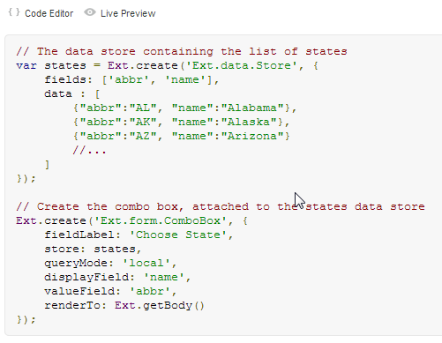
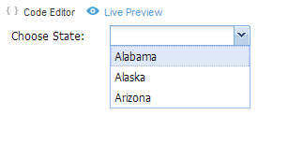
Reviewing ExtJS Documentation

Slide 3
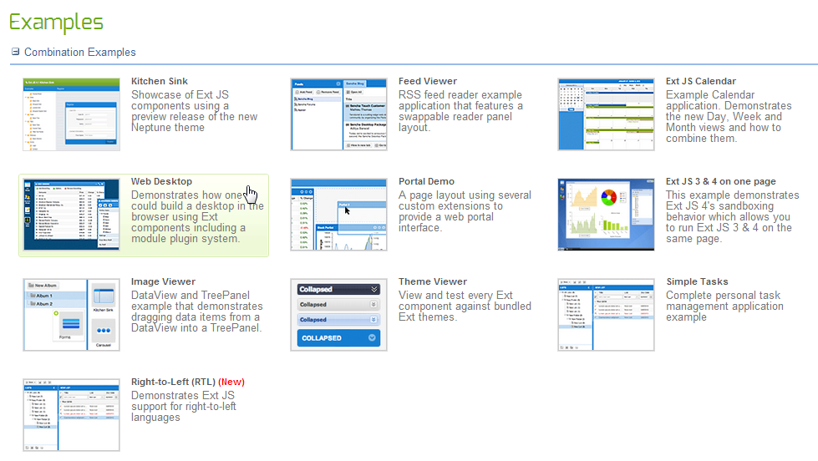
Reviewing ExtJS Examples

Slide 4
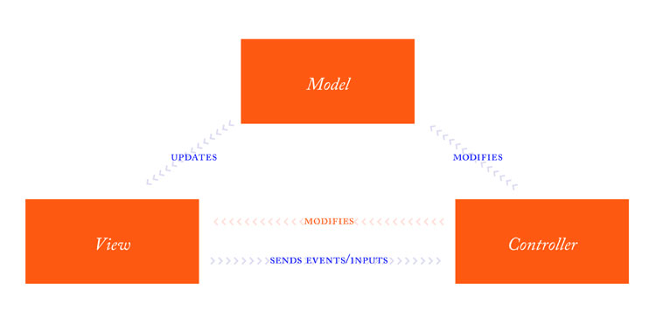
Introduction ExtJS 4 MVC

Slide 5
Creating an ExtJS Project Introduction to Sencha CMD

Slide 6
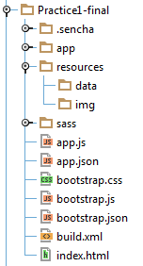
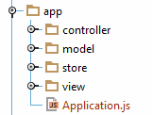
Explaining the folders structure

Slide 7
Understanding extjs files and main application files
ext.js
Basic extjs framework and components classes. Minified and obfuscated
ext-all.js
Complete extjs framework and components classes. Minified and obfuscated.
ext-debug.js
Basic. Not minified or obfuscated
ext-all-debug.js
Complete. Not minified or obfuscated
ext-dev.js
Basic with comments and dev errors. Not minified or obfuscated
ext-all-dev.js
Complete with comments and dev errors. Not minified or obfuscated

Slide 8
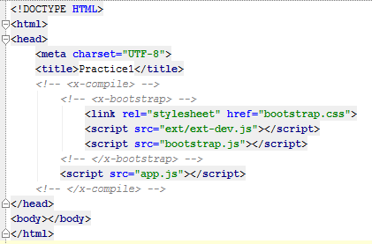
Understanding extjs files and main application files
index.html

Slide 9
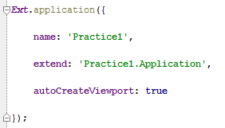
Understanding extjs files and main application files
app.js

Slide 10
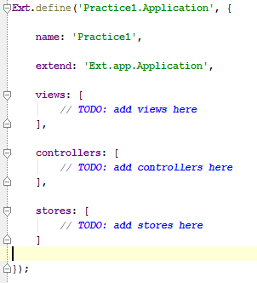
Understanding extjs files and main application files
Application.js

Slide 11
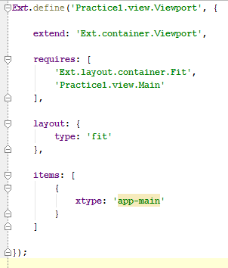
Understanding extjs files and main application files
Viewport.js

Slide 12
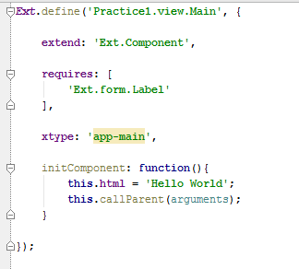
Understanding extjs files and main application files
Main.js

Slide 13
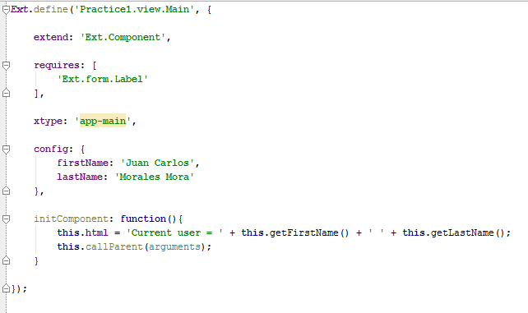
Understanding the class system
Ext.define -> To define a class configuration
Ext.create -> To create an instance of a class

Slide 14
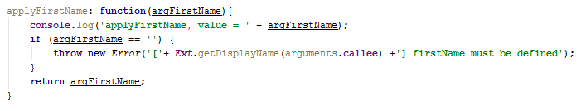

Understanding the class system Apply and Update functions
Apply: Intercepts and validates a value prior to it being stored in the component property
Update: Executed after the property has successfully been set

Slide 15
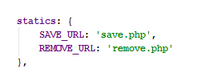
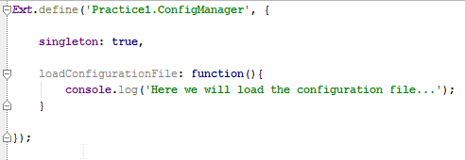
Statics and singletons

Slide 16
Dynamic loading

Slide 17
Creating the launch function
app.js is loaded
All controllers are loaded and their init() methods are called in the order in which they're listed in the Ext.application configuration
If the autoCreateViewport property is set to true, your views/Viewport.js file is loaded into memory and an instance is automatically instantiated
The launch method is executed

Slide 18
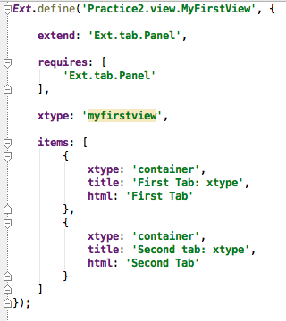
Defining Views Creating a View

Slide 19
Understanding the xtype property

Slide 20
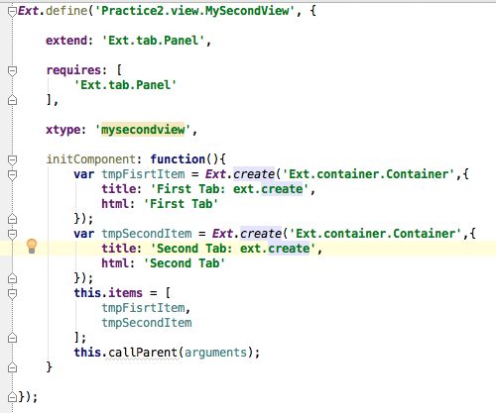
Understanding the xtype property

Slide 21
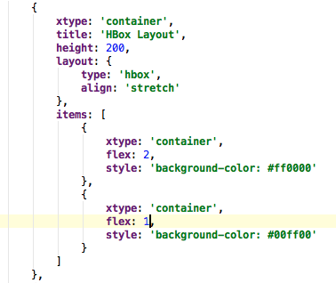
Using the hbox layout

Slide 22
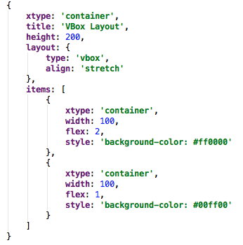
Using the vbox layout

Slide 23
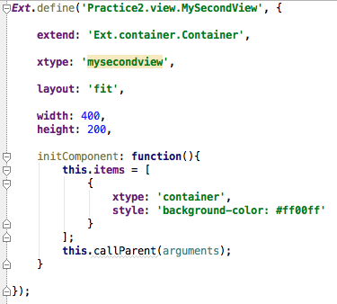
Using the fit layout

Slide 24
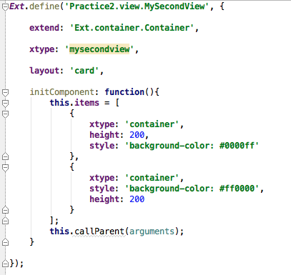
Using the card layout

Slide 25
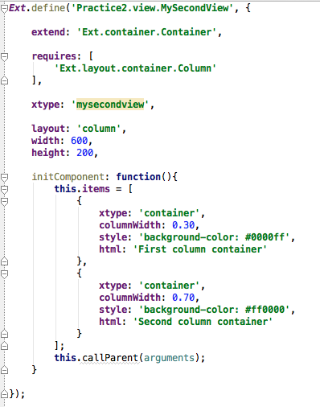
Using the Column layout

Slide 26
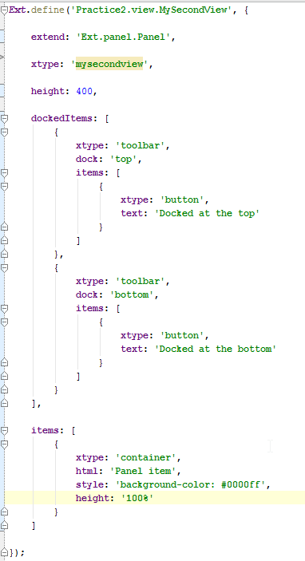
Docking Toolbars

Slide 27
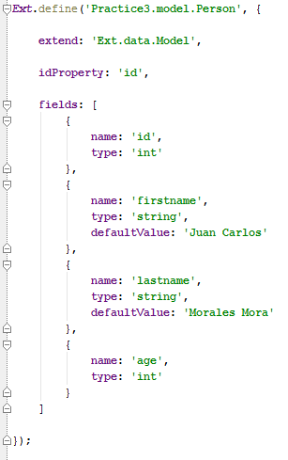
Defining Models and Stores Defining model fields

Slide 28
Defining model fields Data Types
‘auto’, this is the default, no conversion is executed
‘bool’ and ‘boolean’
‘number’ and ‘float’
‘int’ and ‘integer’
‘string’
‘date’

Slide 29
Working with Date fields
Format | Description | Example
‘d’ | Day of the month, 2 digits with leading zeros | 01 to 31
‘j’ | Day of the month without leading zeros | 1 to 31
‘m’ | Numeric representation of a month, with leading zeros | 01 to 12
‘n’ | Numeric representation of a month, without leading zeros | 1 to 12
‘Y’ | A full numeric representation of a year, 4 digits | Examples: 1999 or 2003
‘y’ | A two digit representation of a year | Examples: 99 or 03
‘g’ | 12-hour format of an hour without leading zeros | 1 to 12
‘G’ | 24-hour format of an hour without leading zeros | 0 to 23
‘h’ | 12-hour format of an hour with leading zeros | 01 to 12
‘H’ | 24-hour format of an hour with leading zeros | 00 to 23
‘i’ | Minutes, with leading zeros | 00 to 59
‘s’ | Seconds, with leading zeros | 00 to 59

Slide 30

Working with Date fields

Slide 31
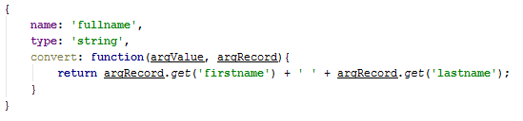
Defining convert functions

Slide 32

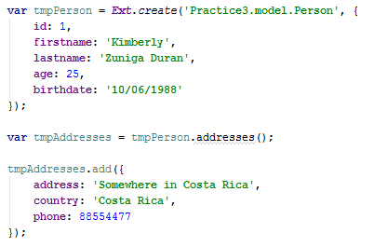
Defining model associations

Slide 33
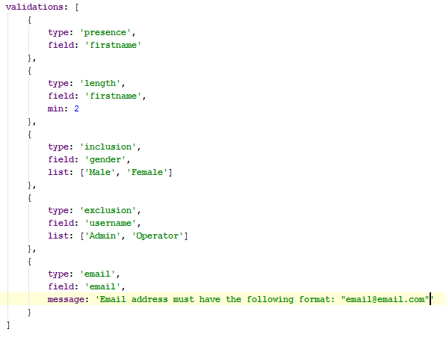
Defining model validations

Slide 34
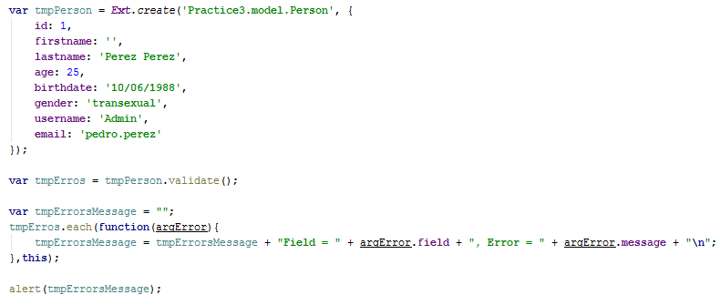
Defining model validations

Slide 35
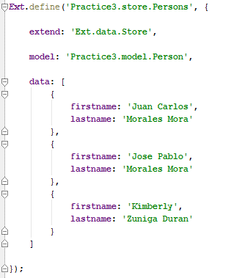
Defining a store

Slide 36
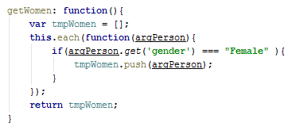
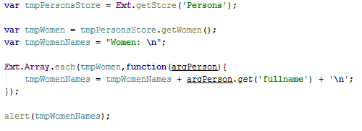
Defining store or models custom functions

Slide 37
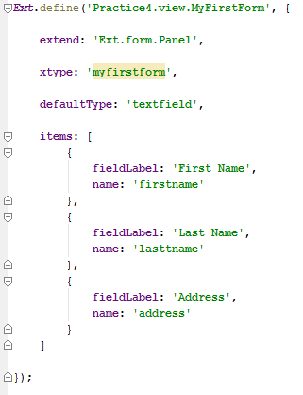
Working with forms Creating a Form

Slide 38

Working with forms Creating a Form

Slide 39
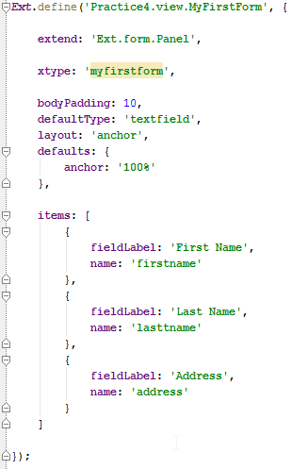
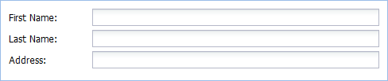
Assigning default configuration values

Slide 40
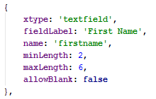
Using Textfields

Slide 41
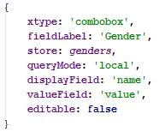
Using ComboBoxes

Slide 42
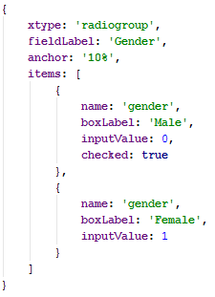
Using RadioGroups

Slide 43
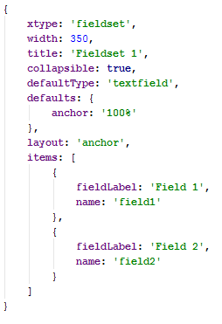

Using the FieldSet component

Slide 44
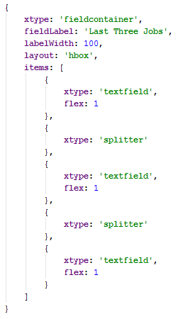
Using the FieldContainer component

Slide 45
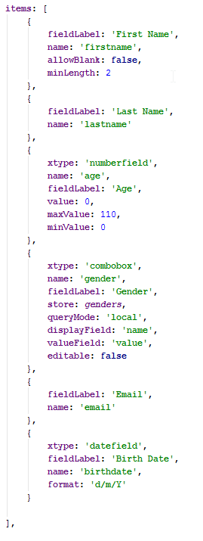
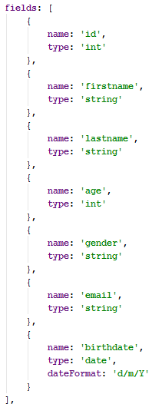
Linking a form to a model

Slide 46
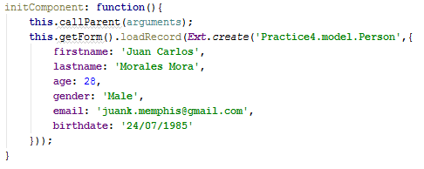
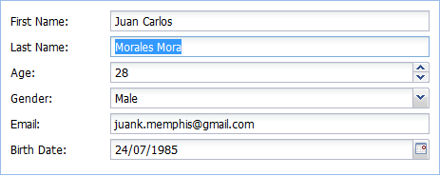
Linking a form to a model

Slide 47
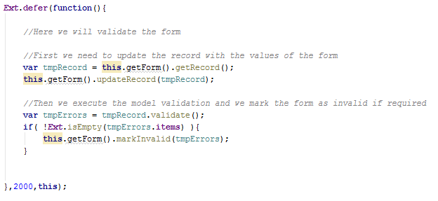
Linking a form to a model Updating and validating the model

Slide 48
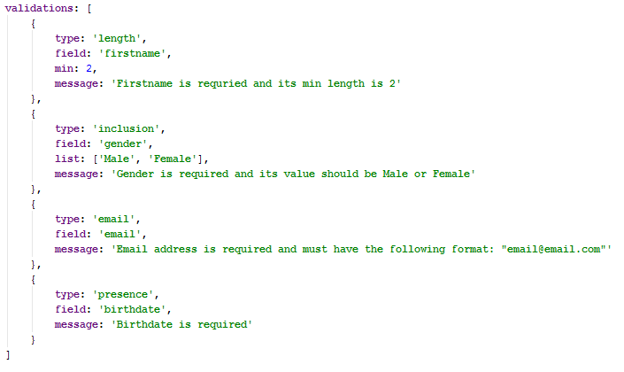
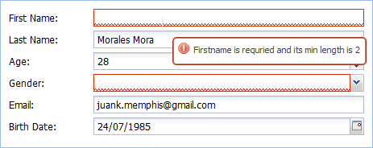
Linking a form to a model Updating and validating the model

Slide 49
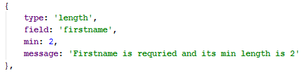
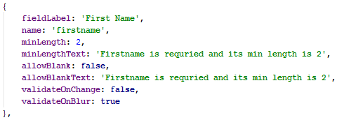
Field validations

Slide 50
Model validations or field validations?

Slide 51

Working with VTypes
Validators para usar en fields
Estan incluidos en la clase Ext.form.field.Vtypes
Los mas comunes son email y url

Slide 52
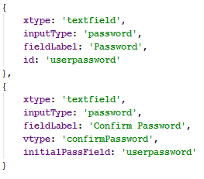
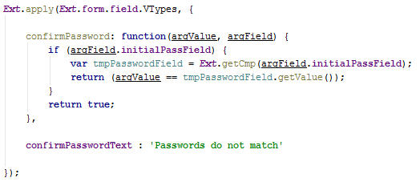
Creating custom vtypes Confirm passwords validator

Slide 53

Creating a grid

Slide 54
Column types
Column Type | Description
Column | Generic column, usually used to display string values
Boolean | Used to output boolean data as strings, e.g. "Yes" or "No"
Date | Used to transform Javascript date objects into human-readable date/time values
Number | Formats numbers as strings
Template | Enables you to use Ext.XTemplate syntax to define the output format of a field
RowNumberer | Displays the current row number for a record
Action | Enables you to place clickable buttons in a column

Slide 55

Defining a Boolean Column

Slide 56

Defining a Date Column

Slide 57

Defining a Number column

Slide 58

Defining a Template column

Slide 59

Defining a RowNumberer column

Slide 60

Defining an Action column

Slide 61

Understanding column renderers

Slide 62


Defining column editors Row Editing and Cell Editing

Slide 63
Loading data locally and from a server Understanding the Proxy class
Name | Type | Description
LocalStorageProxy | Client | Saves its data to localStorage if the browser supports it
SessionStorageProxy | Client | Saves its data to sessionStorage if the browsers supports it
MemoryProxy | Client | Holds data in memory only, any data is lost when the page is refreshed
Ajax | Server | Sends requests to a server on the same domain
JsonP | Server | Uses JSON-P to send requests to a server on a different domain
Rest | Server | Uses RESTful HTTP methods (GET/PUT/POST/DELETE) to communicate with server
Direct | Server | Uses Ext.direct.Manager to send requests

Slide 64
Define the proxy on the model or the store?

Slide 65


Defining a proxy to read a local json file

Slide 66



Defining a proxy to put data in the LocalStorage

Slide 67


Defining a proxy to put data in the SessionStorage

Slide 68

Defining a proxy to read data from a server

Slide 69



Configuring a proxy for data pagination

Slide 70

Defining Controllers Creating a Controller

Slide 71

Defining controllers listeners

Slide 72


Defining controllers refs

Slide 73
Adding components event handlers in the controller or fire custom events from views?

Slide 74

Event handlers in the controller

Slide 75


Fire custom events from views

Slide 76
Adding components event handlers in the controller or fire custom events from views?

Slide 77

Working with templates

Slide 78

Implementing conditional processing

Slide 79

Binding custom javascript methods to XTemplates

Slide 80


Binding a template to a component

Slide 81

Explaining the DataView component

Slide 82

Creating custom components Understanding components life cycle

Slide 83
Generating production builds

Slide 84

Best Practices
Nesting callbacks === nightmare!!!!
Bad Practice

Slide 85

Best Practices
Nesting callbacks === nightmare!!!!
Good Practice

Slide 86


Best Practices
Excessive or unnecessary nesting of component structures
Bad Practice
Good Practice

Slide 87

Best Practices
Memory leaks caused by failure to cleanup unused components
Bad Practice

Slide 88

Best Practices
Memory leaks caused by failure to cleanup unused components
Good Practice

Slide 89
Best Practices
Monster controllers

Slide 90

Best Practices
Poor folder structure for source code
Bad Practice

Slide 91

Best Practices
Poor folder structure for source code
Good Practice

Slide 92

Best Practices
Use of “id”
Bad Practice

Slide 93

Best Practices
Use of “id”
Good Practice

Slide 94

Best Practices
Unreliable referencing of components
Bad Practice

Slide 95

Best Practices
Unreliable referencing of components
Good Practice

Slide 96
Best Practices
Ext.suspendLayouts() and Ext.resumeLayouts()
Use them when you need to perform actions on a
collection of ui components at once

Slide 97


Best Practices
Design classes for configurability
Bad Practice
Good Practice

